Slide 1

Analysis of Economic Indicators OVER TIME ACROSS WORLD
Ilina Jha

Slide 2
INTRODUCTION
Country | Year | GDP Growth (%) | Women Business Law Index Score (Scale 1-100) | Total Population | FDI inflows
Madagascar(Low Income)
India(Low Middle Income)
Brazil( Upper Middle Income)
United States(High Income)
Variables:
Sourced from World Bank

Slide 3
Research Question
How have the variables evolved over time, and are there long-term trends that can be identified for different countries?
Going to have a closer look on, 2008 Financial Crisis, Pandemic 2020

Slide 4

Data Description
For the presentation sticking to just GDP and Women Business Law Index Score

Slide 5
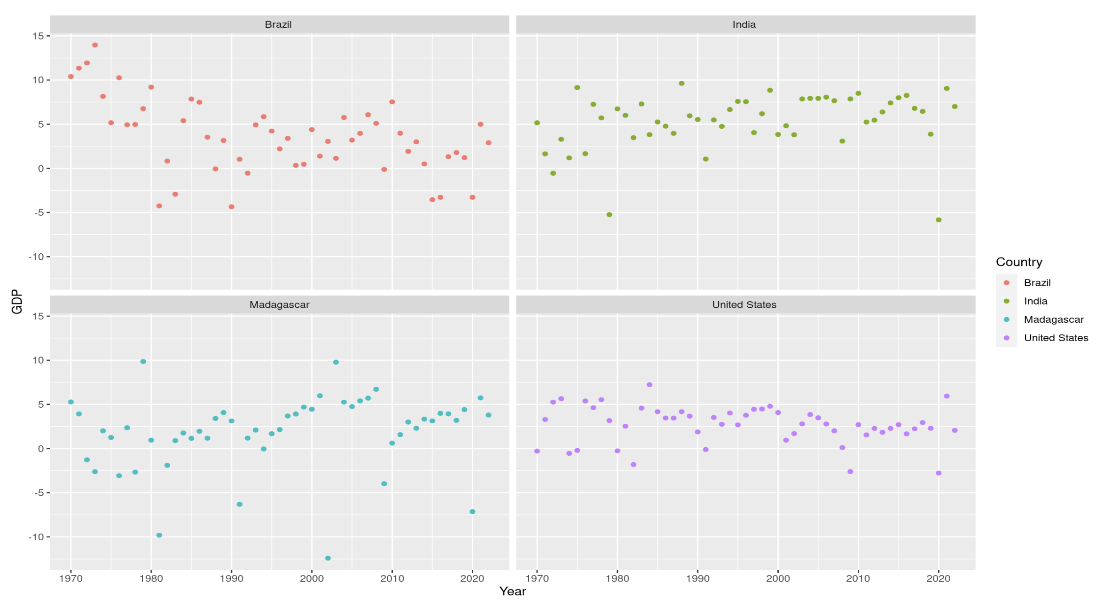

Slide 6
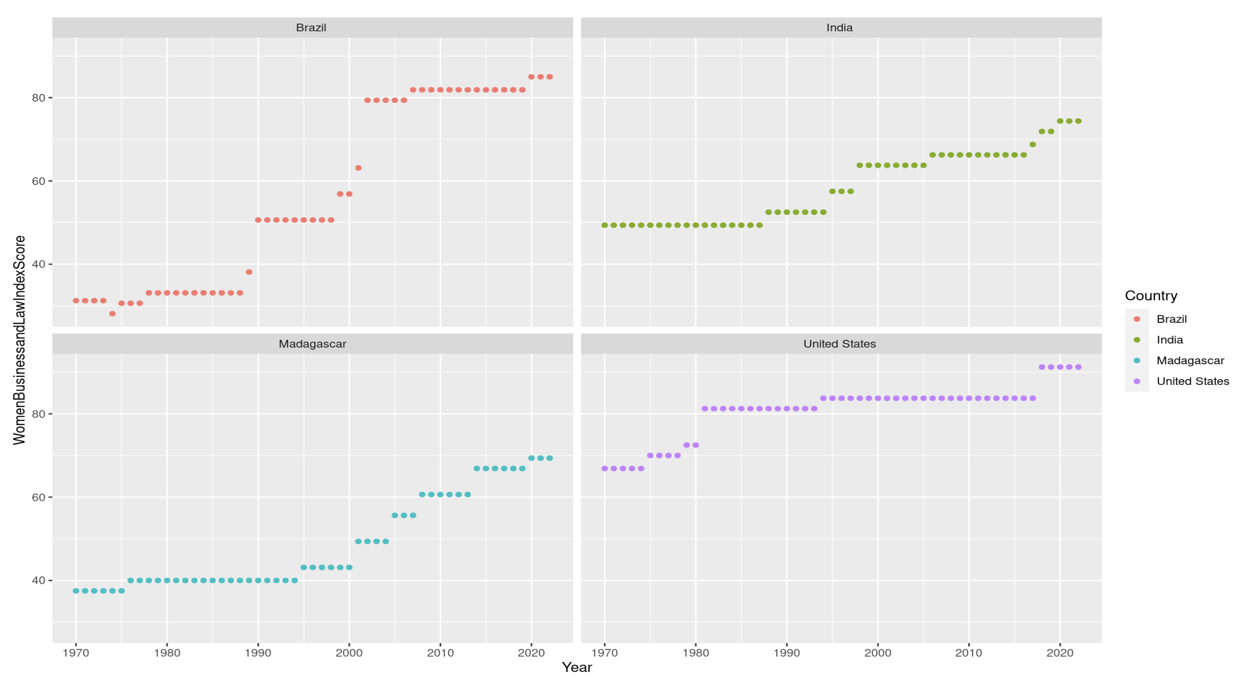

Slide 7
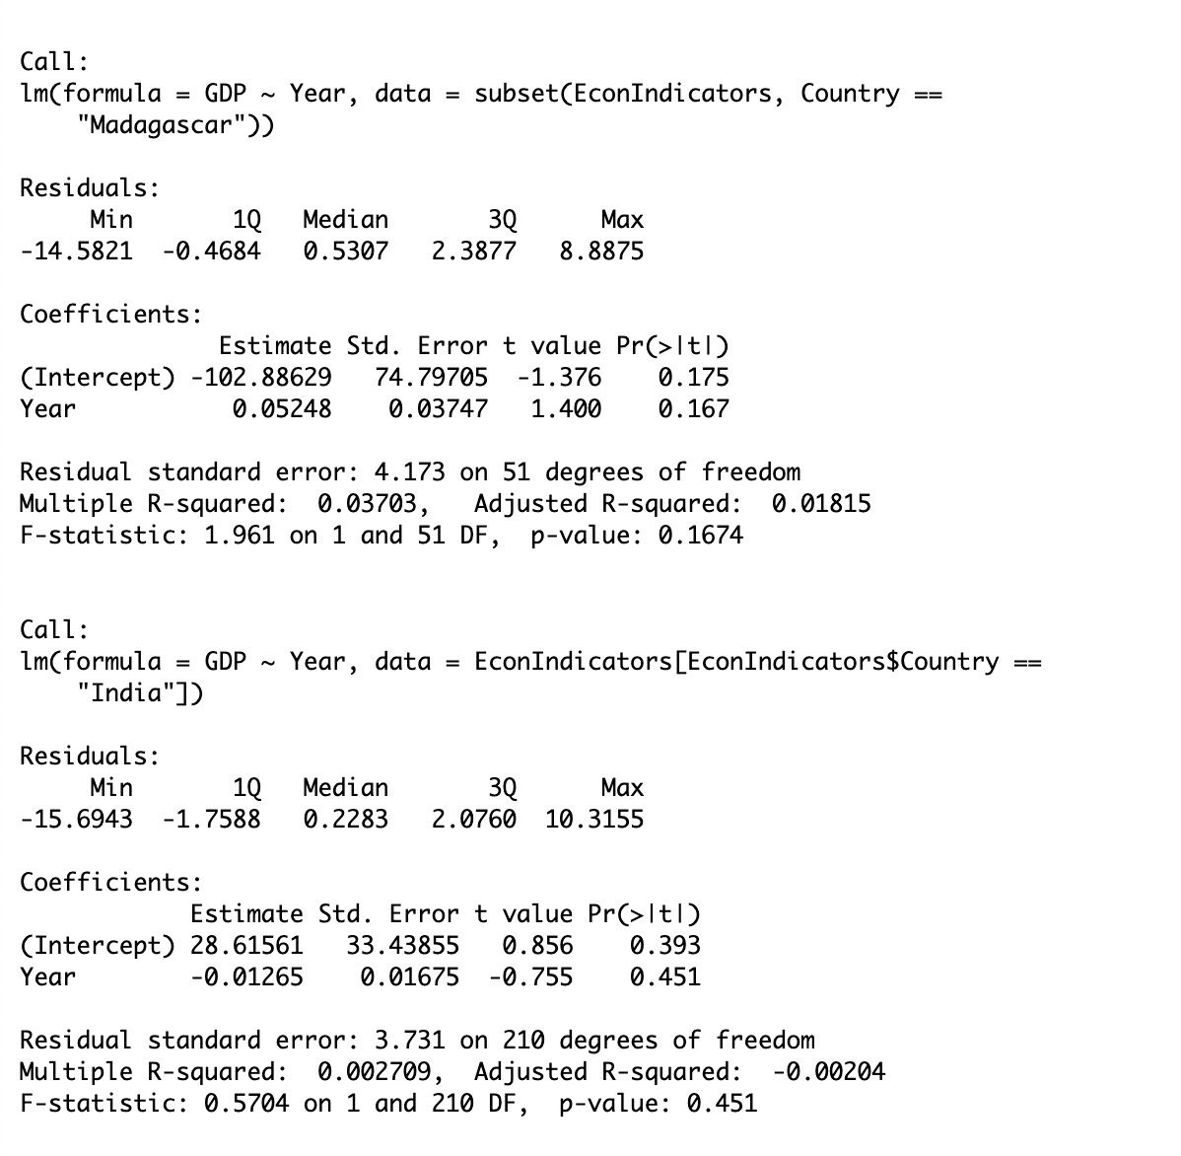
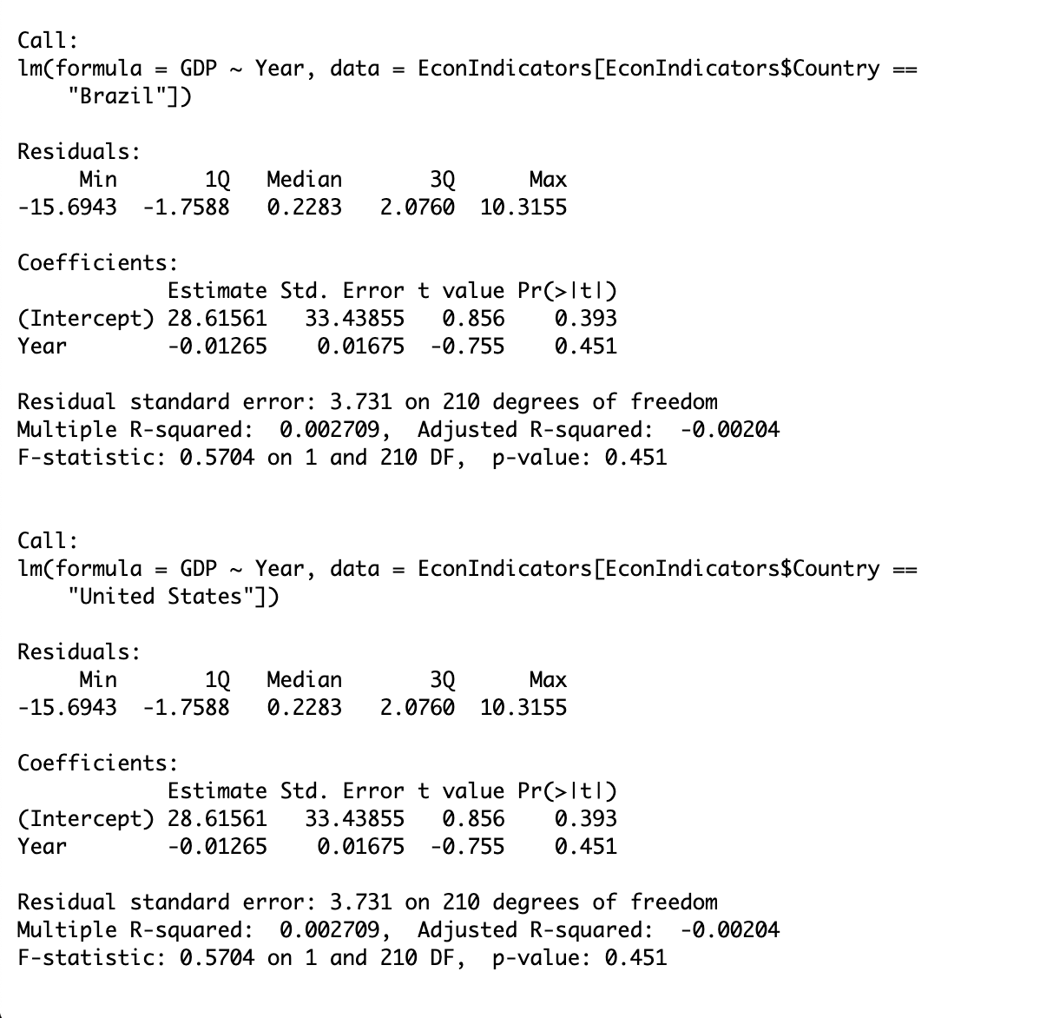
GDP Growth for Countries

Slide 8
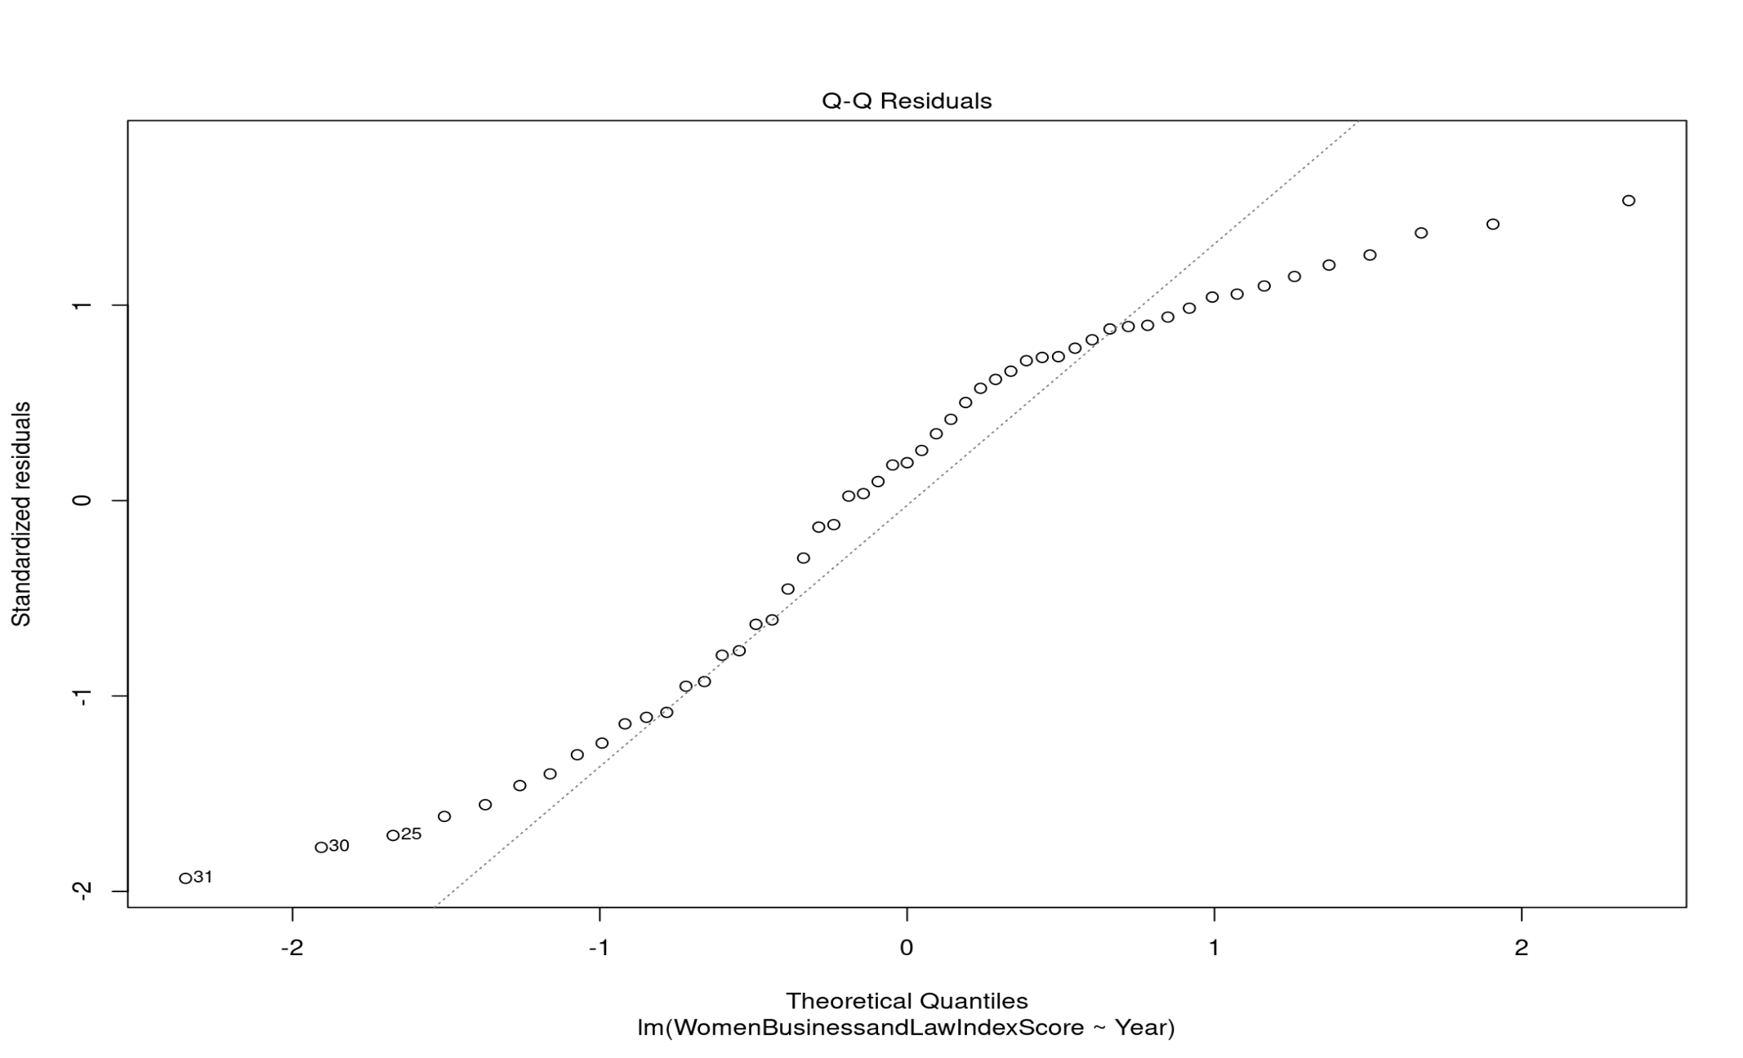
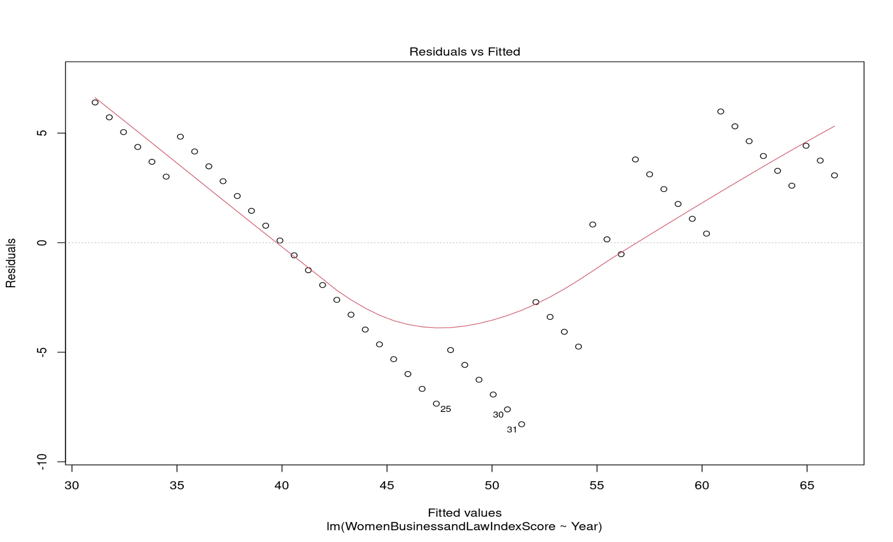
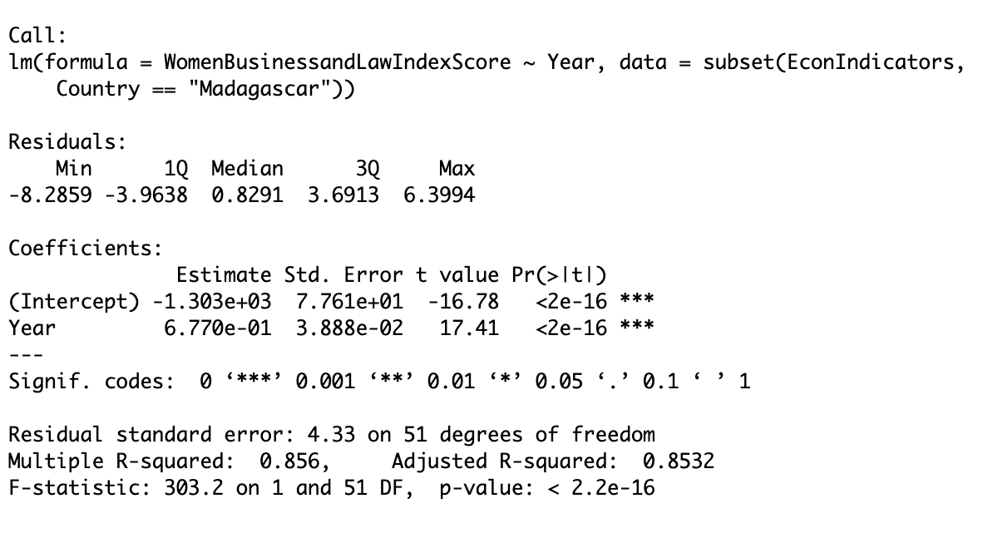
Notes:
A curved pattern in the residuals plot could indicate heteroscedasticity, suggesting that the variability of the errors changes with the level of the fitted values, The relationship between the variables may be more complex than a linear model can capture

Slide 9
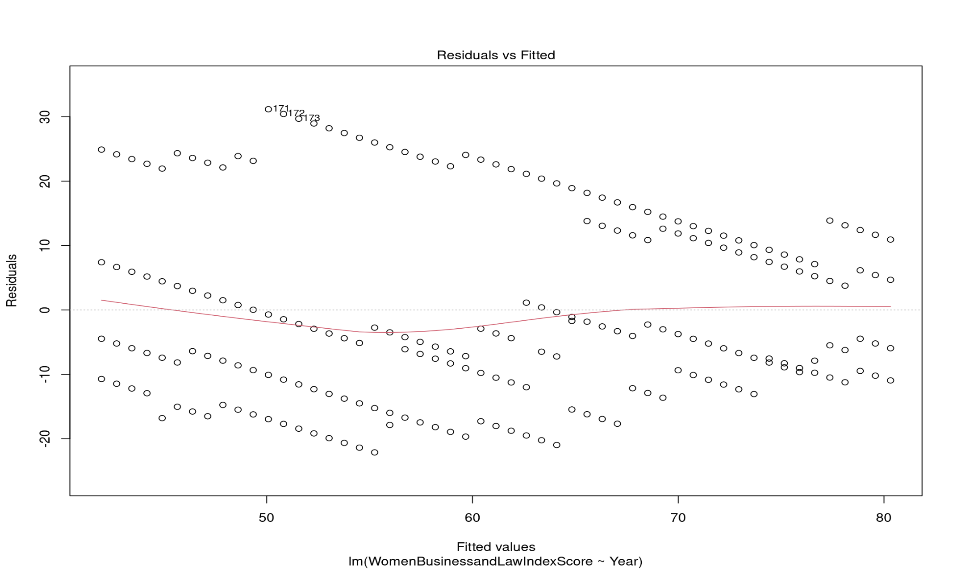
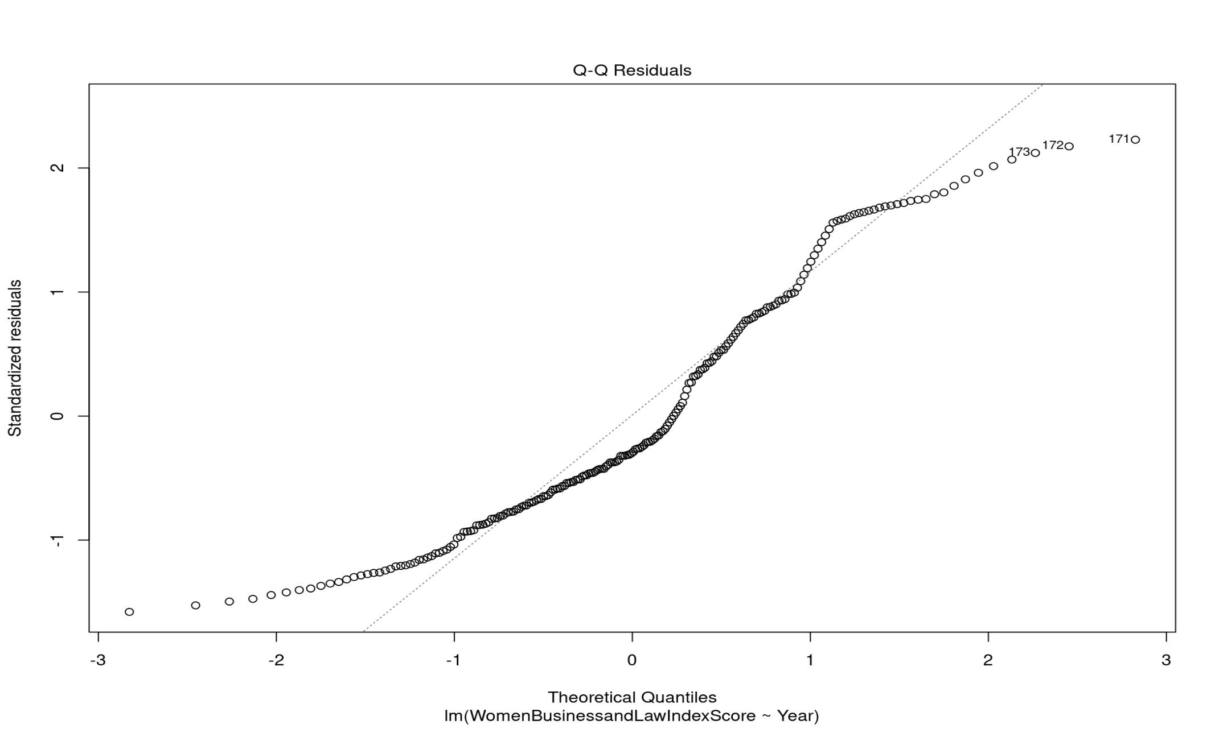
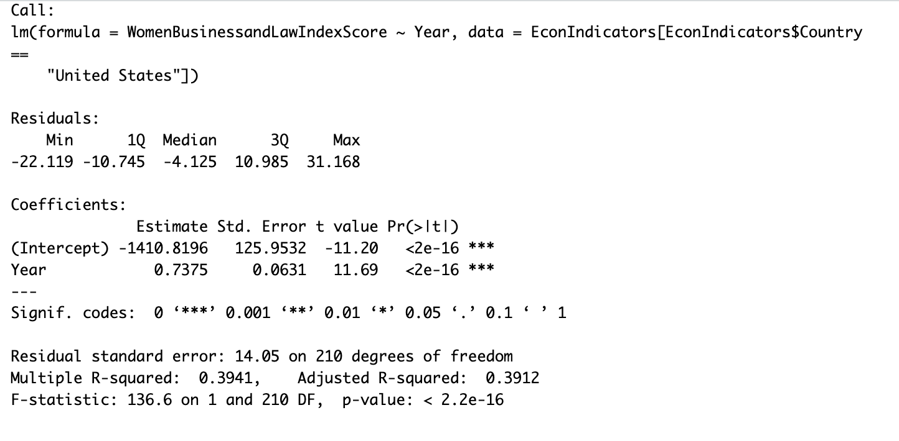

Slide 10
Why not Simple linear Regression?
GDP Relationship: No statistically significant linear relationship with Year (p-value > significance level).
Women in Business and Law Index Score Relationship: Significant relationship with Year, suggesting a complex relationship beyond linearity. Heteroscedasticity indicates varying error variability with fitted values. The model might not fully capture the intricate nature of this relationship.

Slide 11
Spline : Piecewise linear Regression Model
Relationship between the independent and dependent variables is not strictly linear and exhibits breakpoints.
Piecewise regression allows the us to model different segments of the data with separate linear relationships, and splines provide a flexible way to capture nonlinearity.
Better for visualization

Slide 12
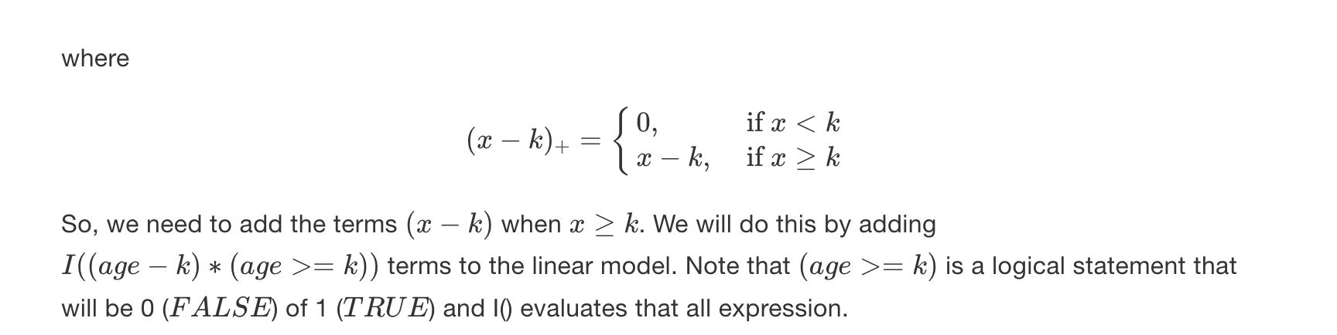
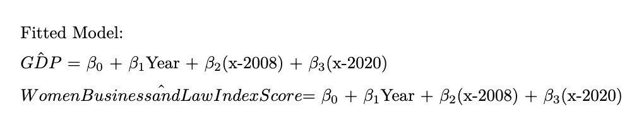
Theoretical Model and Fitted Model
Notes:
https://bookdown.org/tpinto_home/Beyond-Linearity/piecewise-regression-and-splines.html ( Theoretical Model)
X –k will alow the curve to have some slope

Slide 13
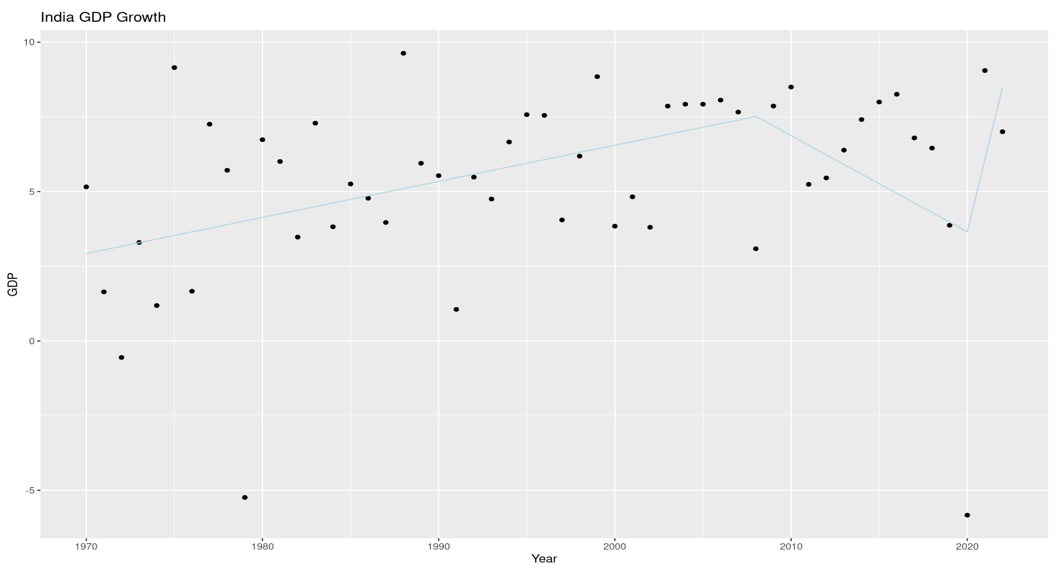
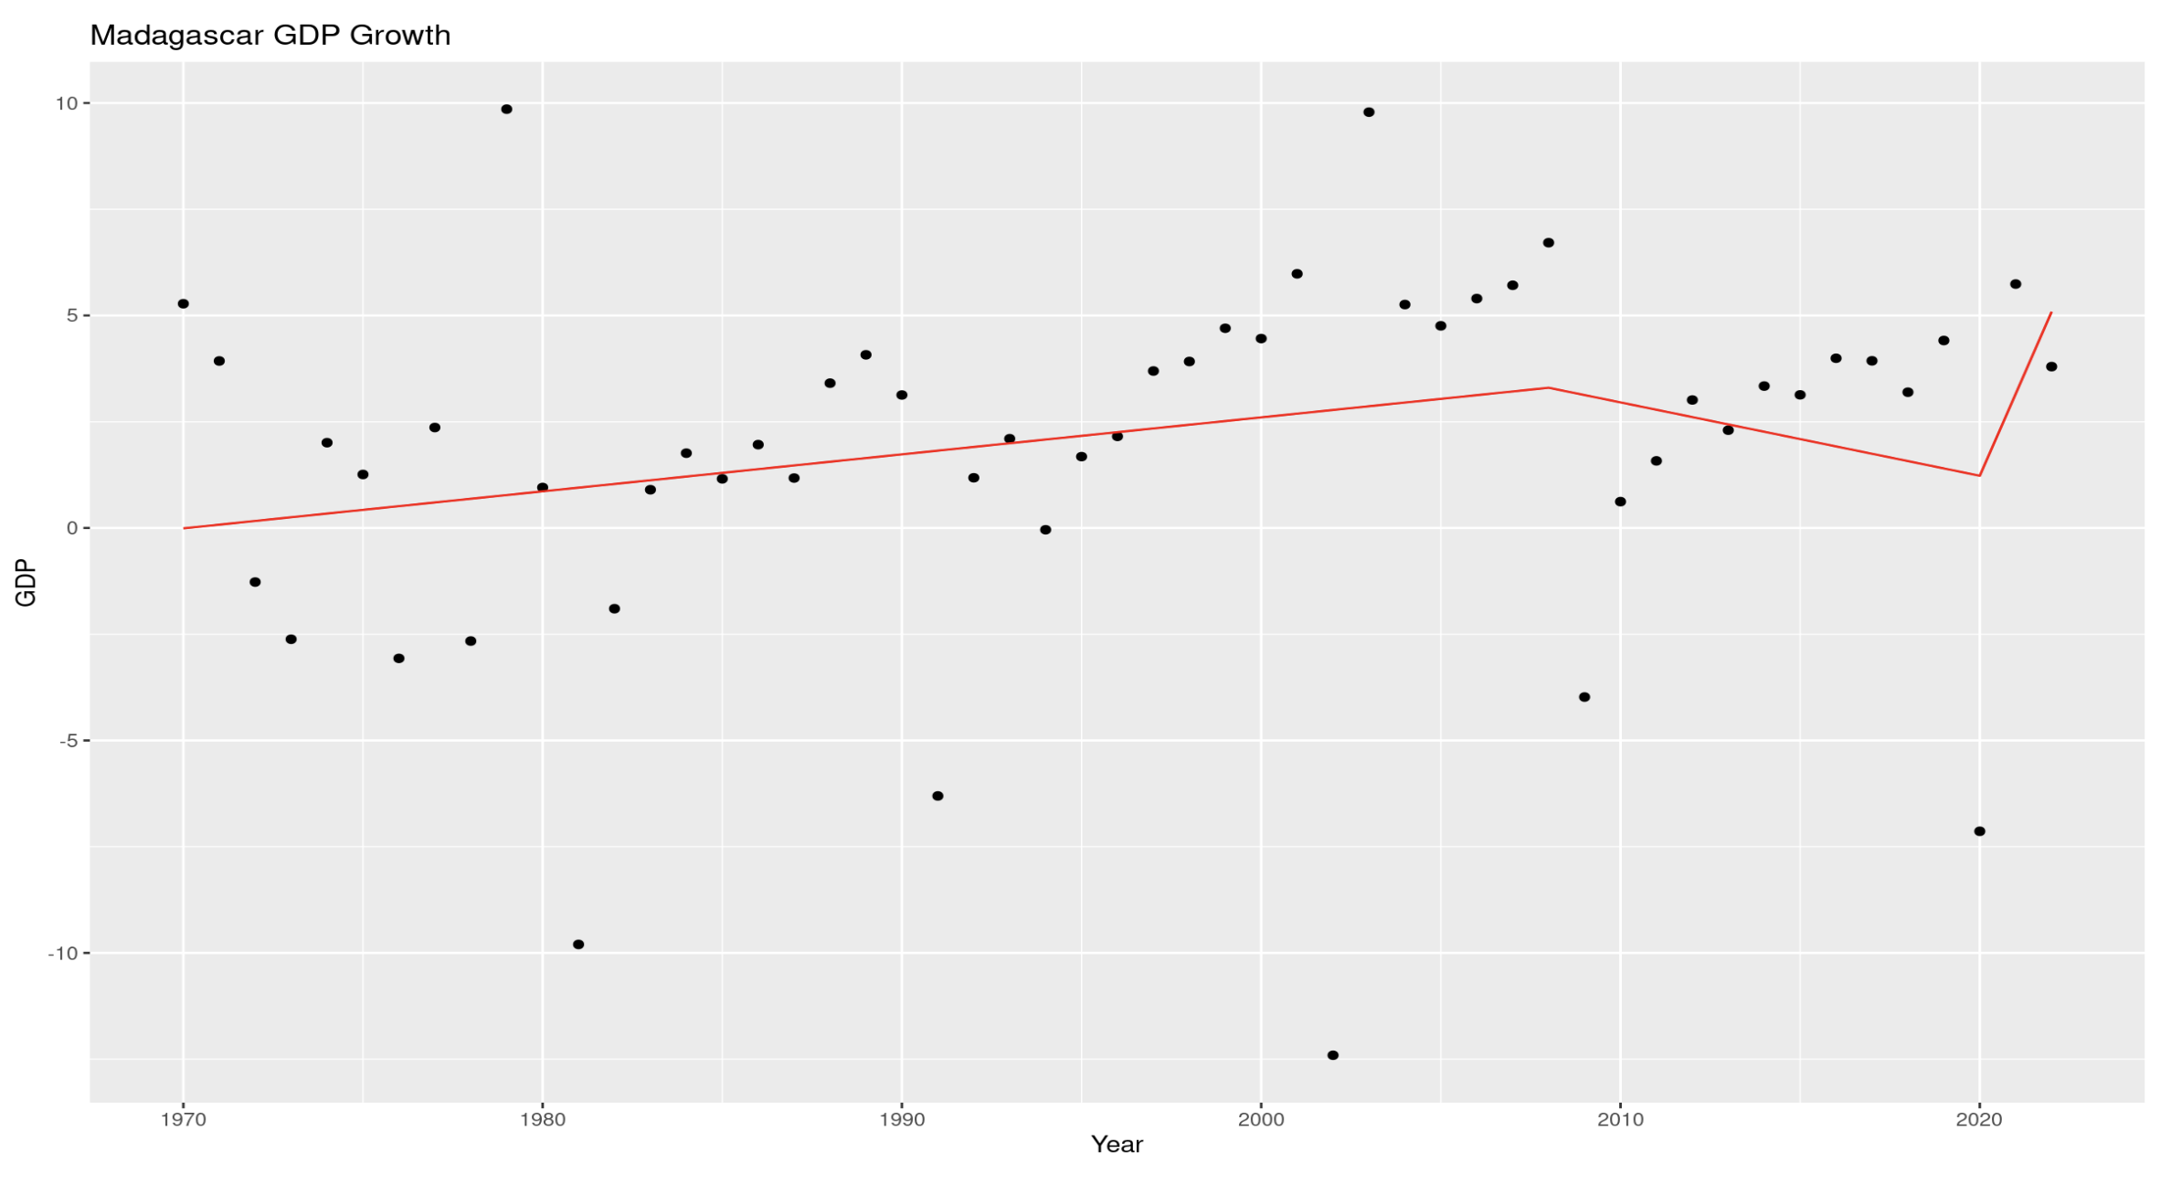
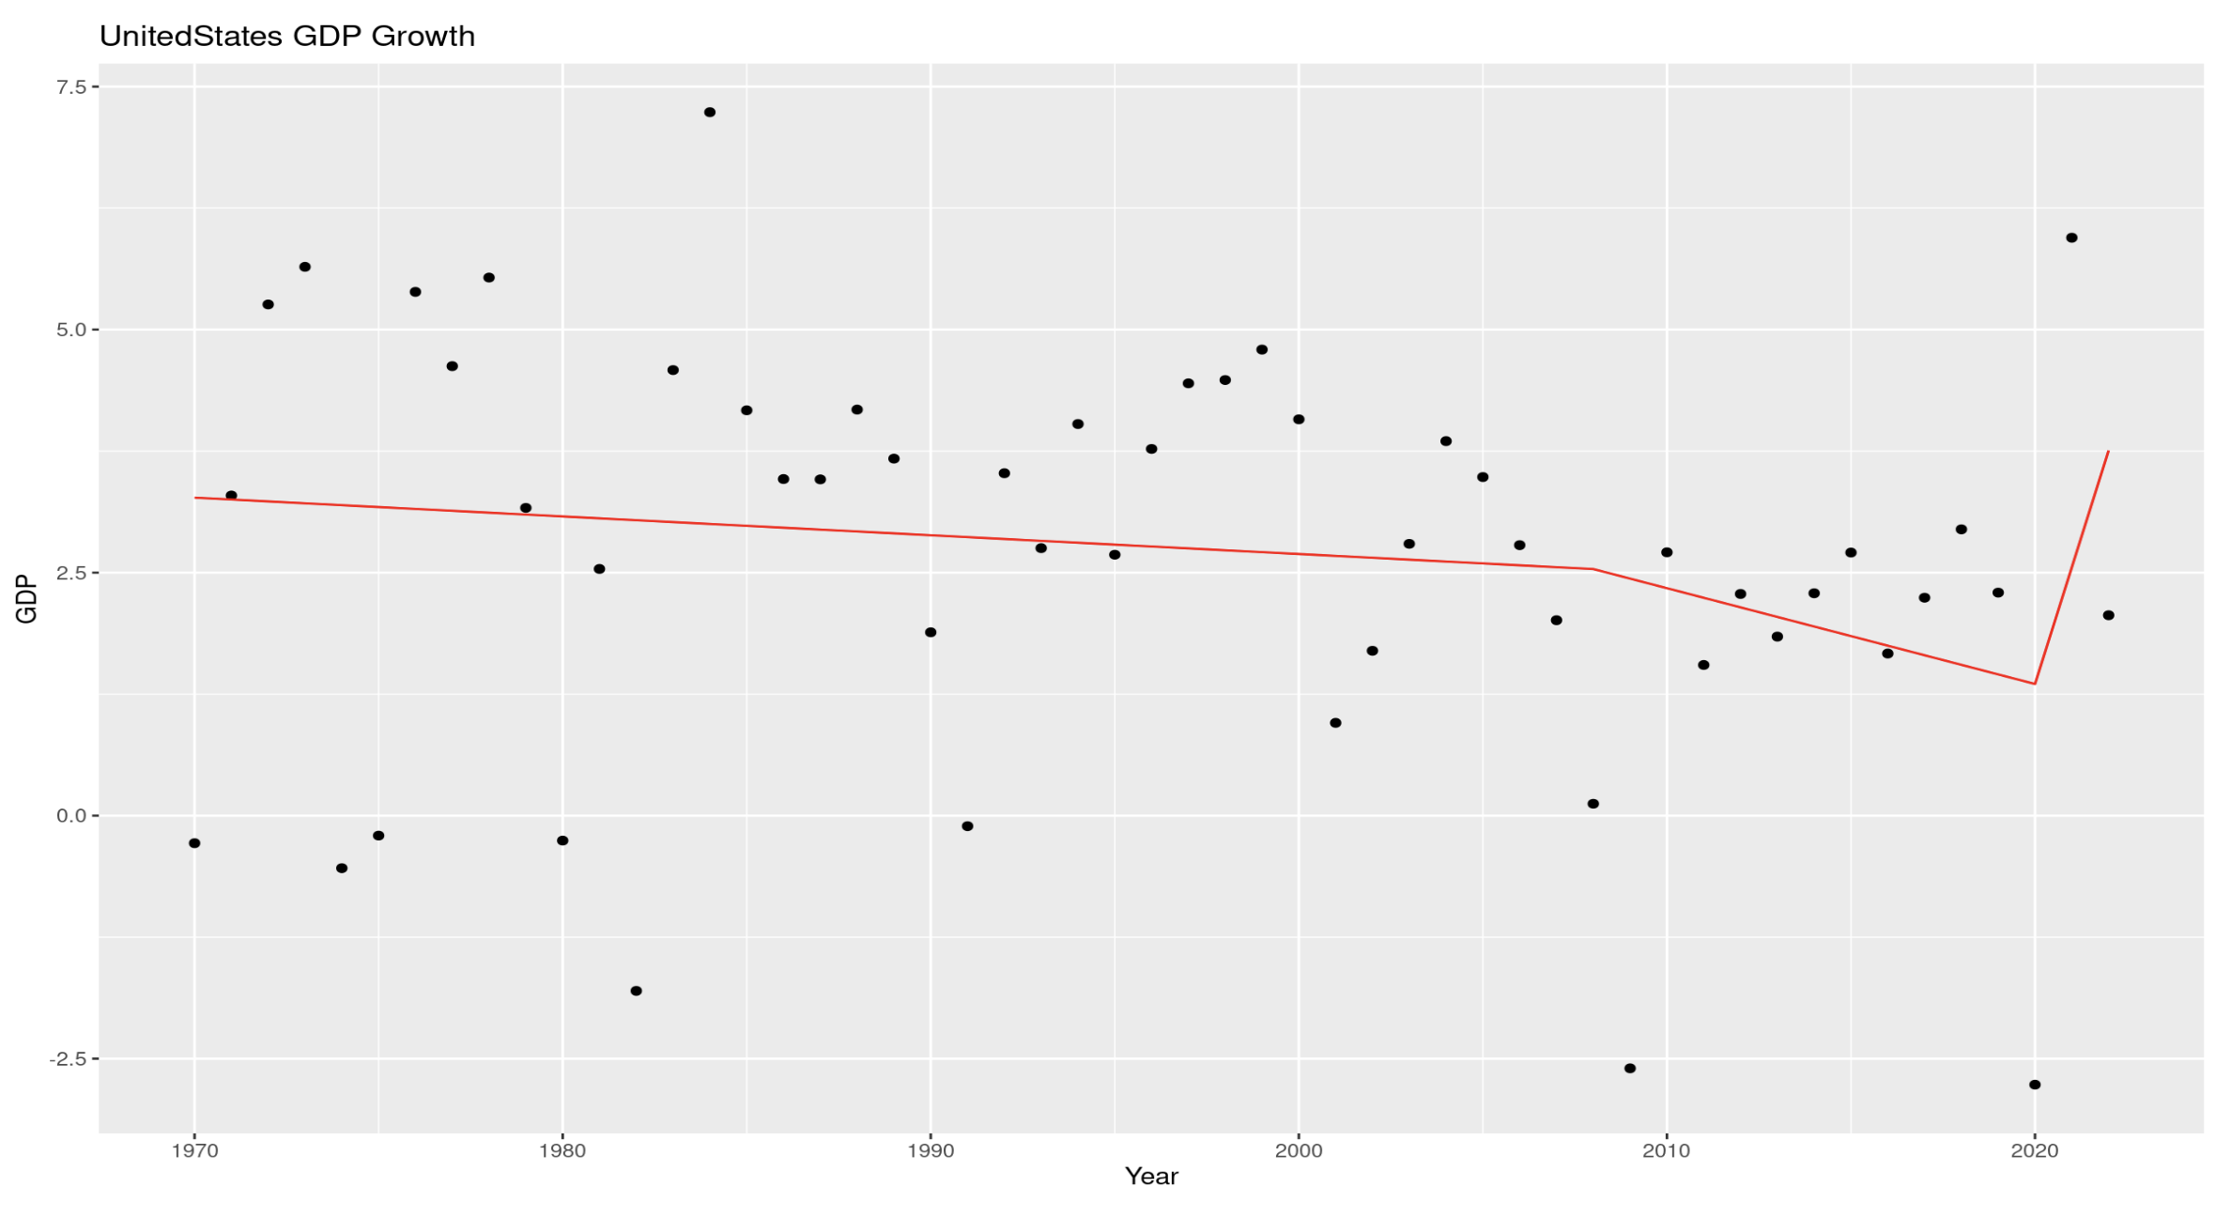
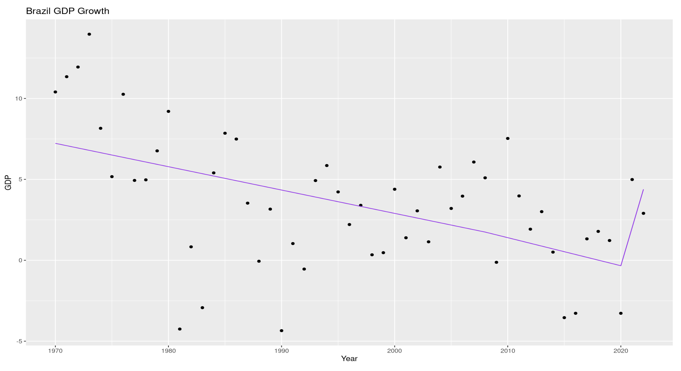
GDP Growth

Slide 14
Summaries
India:
Before 2008: GDP increased by 0.12 units per year.
Between 2008 and 2020: GDP decreased by 0.44 units per year.
After 2020: GDP increased by 2.74 units per year.
The overall model explains about 18.91% of the variance in GDP.
Madagascar:
Before 2008: GDP increased by 0.087 units per year.
Between 2008 and 2020: The trend is negative but not statistically significant.
After 2020: GDP increased by 2.10 units per year.
The overall model explains about 6.16% of the variance in GDP.
Brazil:
Before 2008: GDP decreased by 0.14 units per year.
Between 2008 and 2020: The trend is not statistically significant.
After 2020: GDP increased by 2.53 units per year.
The overall model explains about 27.38% of the variance in GDP.
United States:
Before 2008: GDP decreased by 0.019 units per year.
Between 2008 and 2020: GDP decreased by 0.079 units per year.
After 2020: GDP increased by 1.30 units per year.
The overall model explains about 5.9% of the variance in GDP

Slide 15
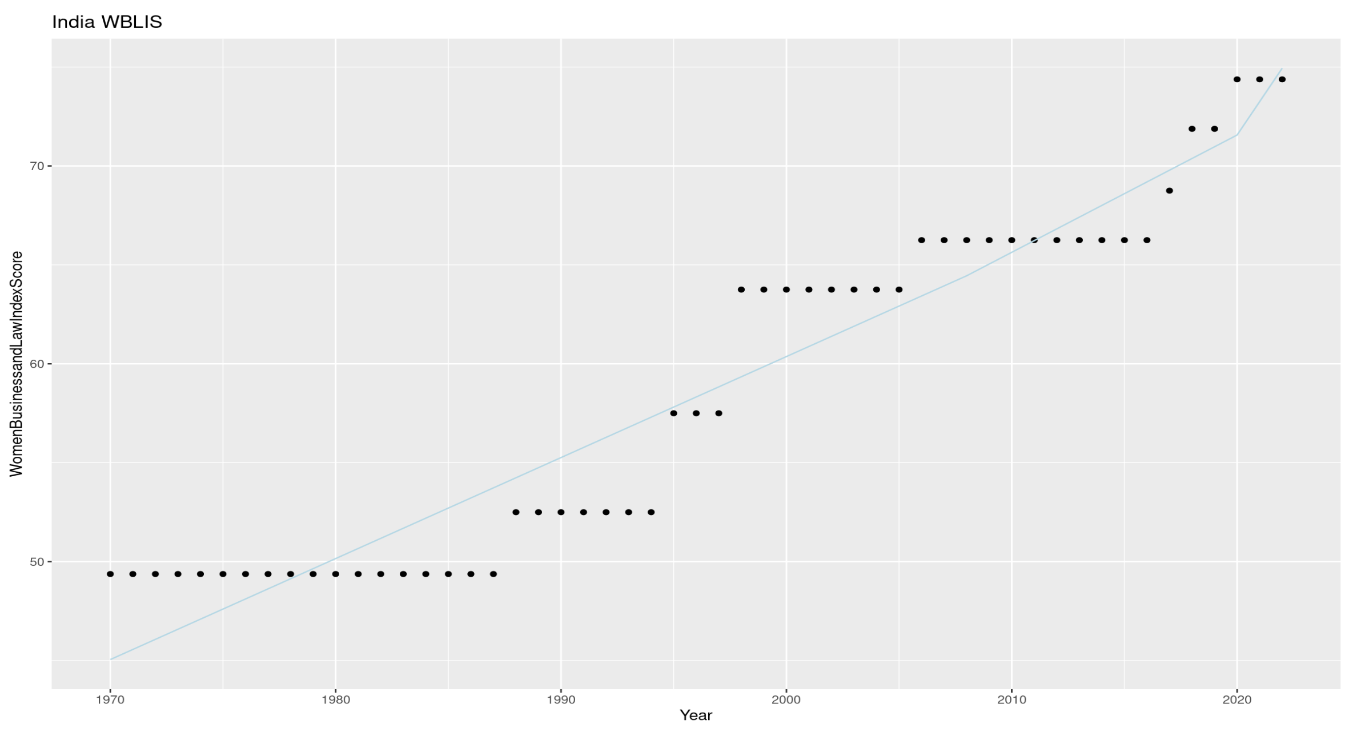
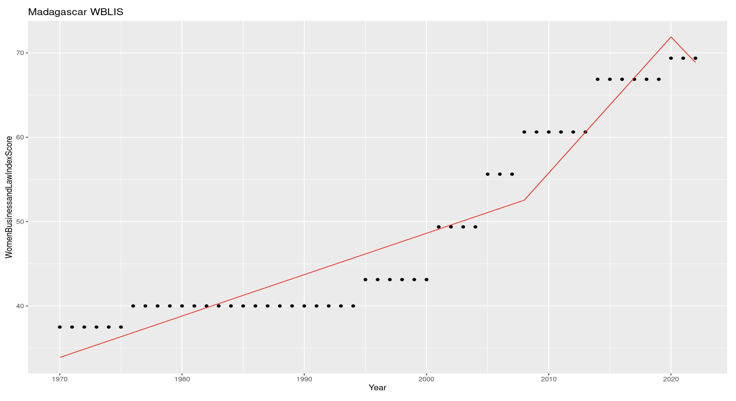
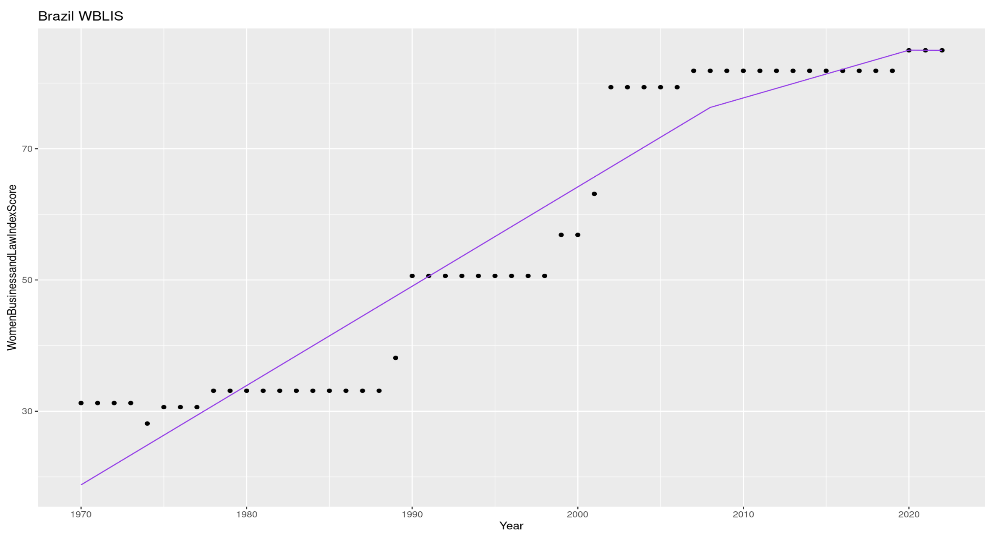
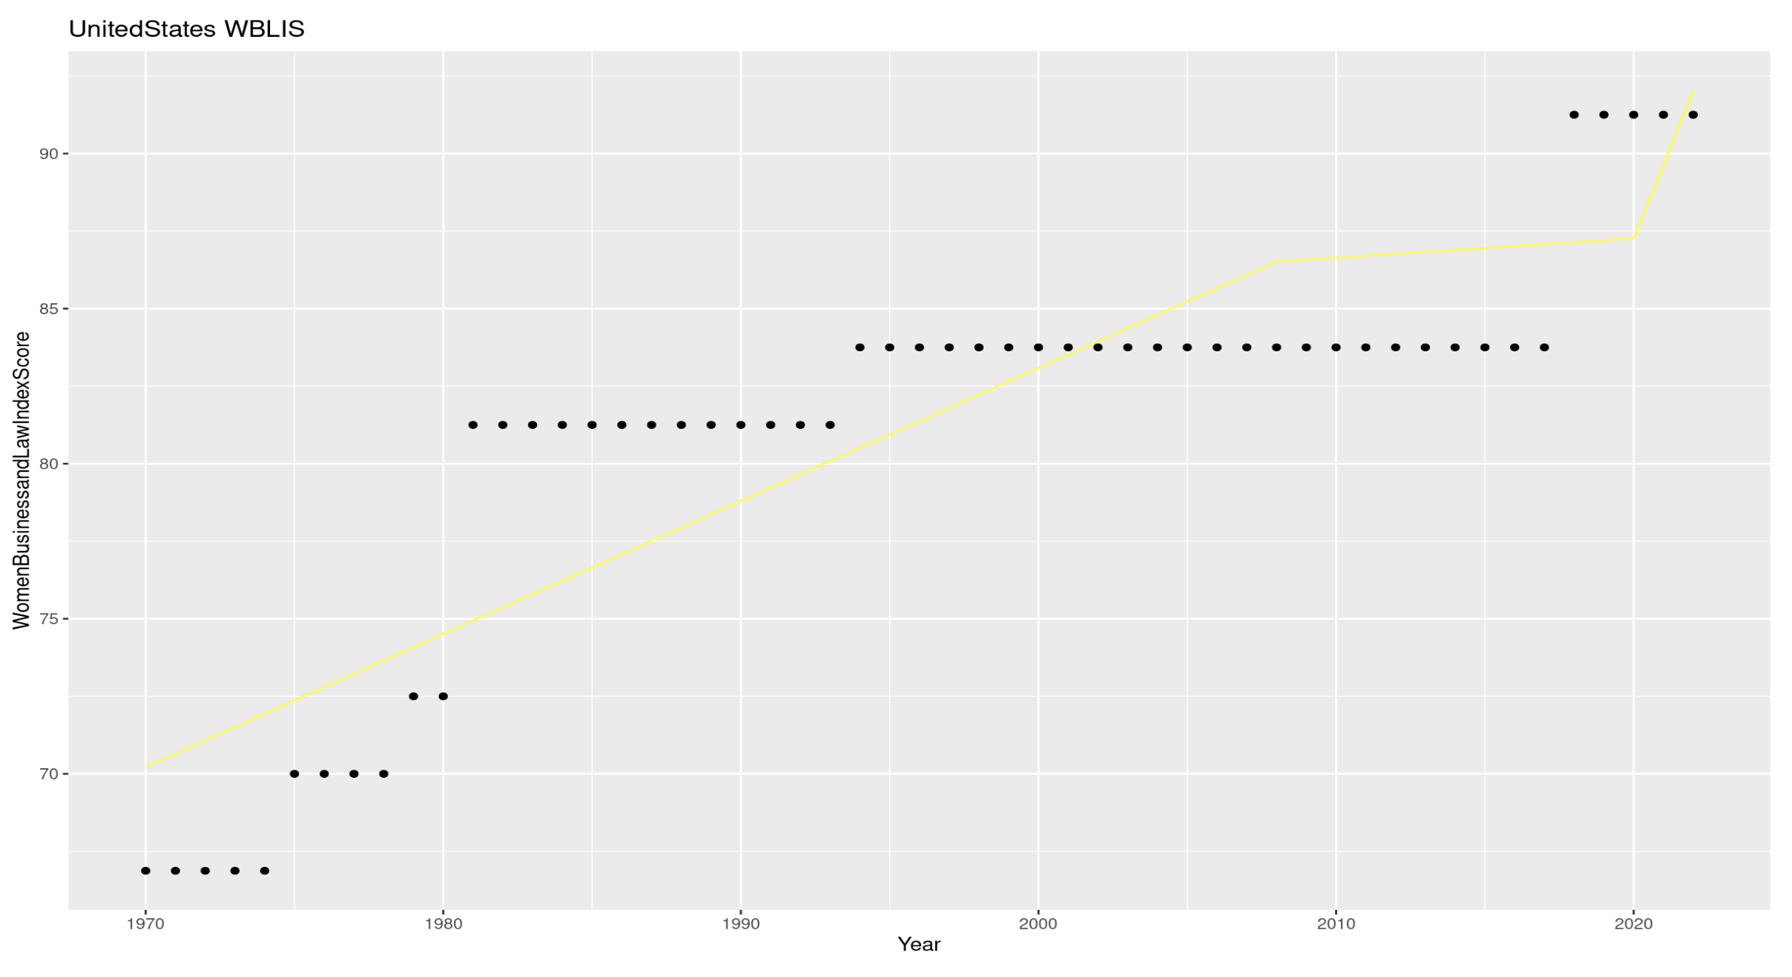
Women in Business and Law Index Score

Slide 16
Summaries for Index Score
India:
Positive trend in Women Business and Law Index Score over the years.
Slight positive shift after 2008.
Positive shift after 2020.
Overall positive impact of time on the score.
Madagascar:
Positive trend in Women Business and Law Index Score over the years.
Significant positive shift after 2008.
Negative shift after 2020 (not statistically significant).
Overall positive impact of time on the score.
Brazil:
Positive trend in Women Business and Law Index Score over the years.
Negative shift after 2008 (not statistically significant).
Negative shift after 2020 (not statistically significant).
Overall positive impact of time on the score.
United States:
Positive trend in Women Business and Law Index Score over the years.
Negative shift after 2008 (not statistically significant).
Positive shift after 2020 (not statistically significant).
Overall positive impact of time on the score.

Slide 17
Interpretations
GDP: The trends in GDP growth vary among the countries, with some experiencing dips and others showing consistent growth. The year 2020 seems to be a crucial point affecting the trajectories.
Women Business and the Law Index Score: Generally, there's an increasing trend, indicating improvements in legal rights and protections for women. However, Madagascar shows a deviation with a dip after 2020, suggesting a unique pattern.
Notes:
https://blogs.worldbank.org/nasikiliza/madagascar-womens-empowerment-gaining-ground#:~:text=In%20Madagascar%2C%20women%20face%20economic,that%20compose%20the%20current%20government. (Refrence for explaination)

Slide 18
Strengths and Weakness
Captures changes in trends over time
Improves the fit and explain more variance in the data
Knots might result in underfitting, where the model fails to capture important nuances in the data
Sensitivity to Knot Placement
Risk of Overlooking Nonlinear Patterns

Slide 19
Thank you

